Slide 1
TAKE-HOME LAB 5
Loop, Algorithm Analysis, Recursion

Slide 2
1. JOGGING
Looping technique

Slide 3
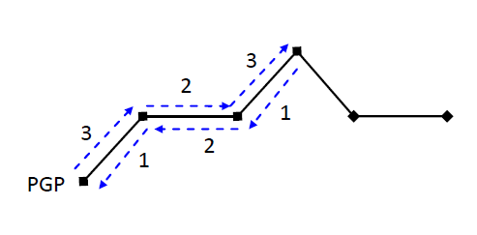
Preliminary
Given time constraint M, T units of road, U seconds to run one unit of uphill road, F seconds to run one unit of flat road, D seconds to run one unit of downhill road, calculate the farthest distance that he can run.

Slide 4
Ideas
Add Up and Down together
Add 2x flat road together
Each time you move, add the “to and fro” timing
Once past the time, return maximum distance
3+1 = 4
2+2 = 4
3+1 = 4
If T = 10, then 4 + 4 + 4 > 10, return 8

Slide 5
2. Triplet
Complexity of Algorithm

Slide 6
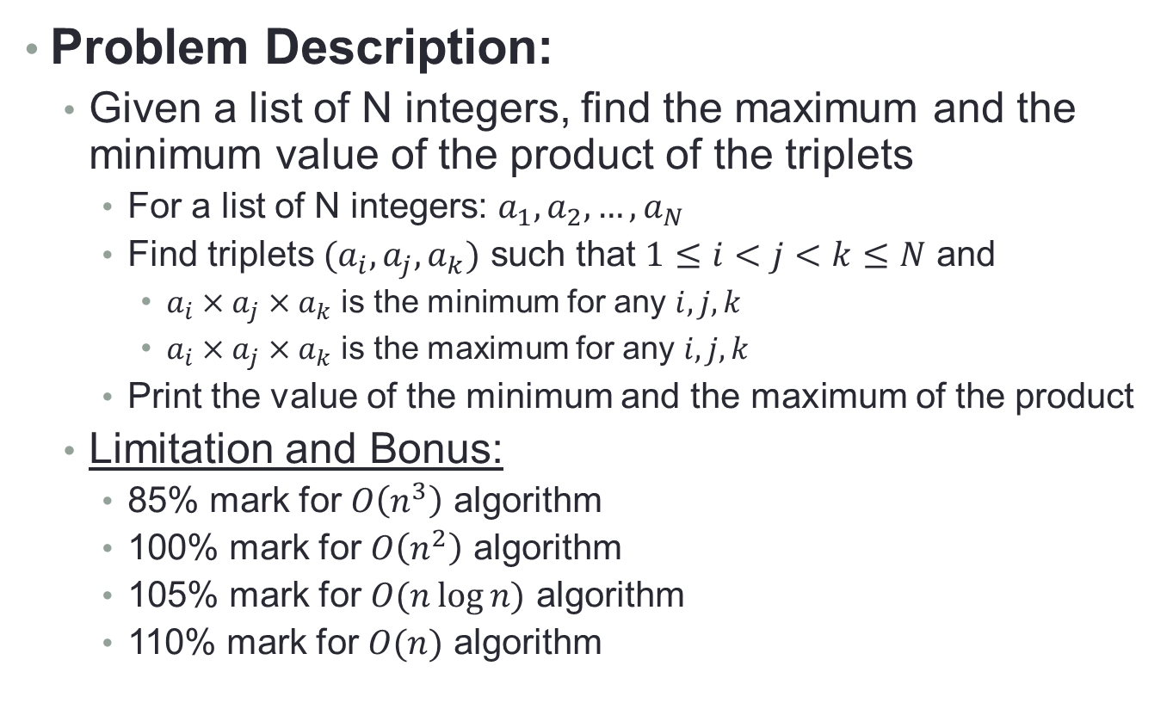
Preliminary
Problem Description:
Given a list of N integers, find the maximum and the minimum value of the product of the triplets
For a list of N integers: $a_{1},a_{2},…,a_{N}$
Find triplets $(a_{i},a_{j},a_{k})$ such that $1≤i<j<k≤N$ and
$a_{i}×a_{j}×a_{k}$ is the minimum for any $i,j,k$
$a_{i}×a_{j}×a_{k}$ is the maximum for any $i,j,k$
Print the value of the minimum and the maximum of the product
Limitation and Bonus:
85% mark for $O\left(n^{3}\right)$ algorithm
100% mark for $O\left(n^{2}\right)$ algorithm
105% mark for $O(n\log{n)}$ algorithm
110% mark for $O(n)$ algorithm

Slide 7
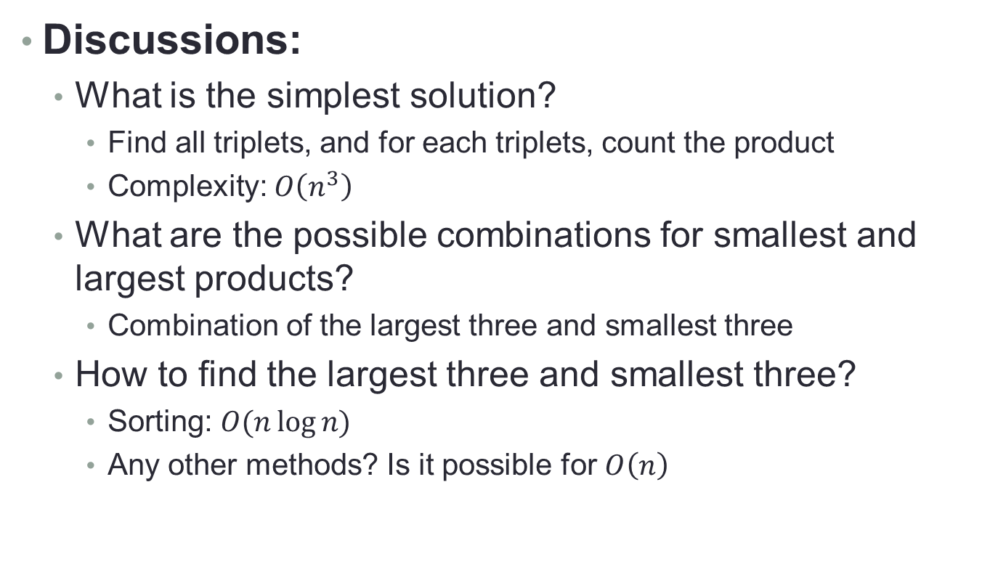
Ideas
Discussions:
What is the simplest solution?
Find all triplets, and for each triplets, count the product
Complexity: $O\left(n^{3}\right)$
What are the possible combinations for smallest and largest products?
Combination of the largest three and smallest three
How to find the largest three and smallest three?
Sorting: $O(n\log{n)}$
Any other methods? Is it possible for $O\left(n\right)$

Slide 8
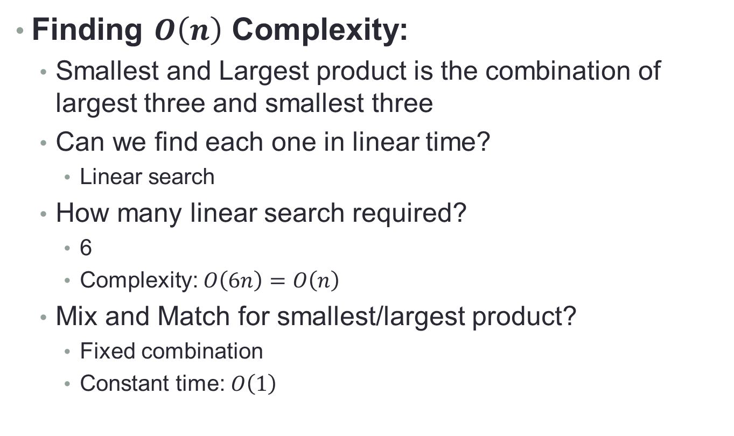
Ideas
Finding $O\left(n\right)$ Complexity:
Smallest and Largest product is the combination of largest three and smallest three
Can we find each one in linear time?
Linear search
How many linear search required?
6
Complexity: $O\left(6n\right)=O\left(n\right)$
Mix and Match for smallest/largest product?
Fixed combination
Constant time: $O\left(1\right)$

Slide 9
Algorithms
Brute Force
public int largest() { int largest = num[0]*num[1]*num[2]; for (int i=0; i<N; i++) { for (int j=i; j<N; j++) { for (int k=j; k<N; k++) { if (largest < num[i]*num[j]*num[k]) { largest = num[i]*num[j]*num[k]; } } } } return largest }

Slide 10
Algorithms
Sorting Method:
public int smallest() { sort(num); // use any n log n sort method triplet_products[0] = max*second_max*third_max; triplet_products[1] = max*second_max*min; triplet_products[2] = min*second_min*third_min; triplet_products[3] = min*second_min*max; return find_smallest(triplet_products); }

Slide 11
Algorithms
Linear Inline Methods
public int largest() { for (int i=0; i<N; i++) { if (max < num[i]) { // shift down third_max = second_max; second_max = max; max = num[i]; } else if (second_max < num[i]) { … } } else if (third_max < num[i]) { … } } // triplet_product code and find_largest here }

Slide 12
3. N Choose K
Recursion

Slide 13
Preliminary
Problem Description:
Find all possible combinations of choosing K letters out of an input string of N distinct letters.
Input:
An integer K and N distinct letters listed in alphabetical order.
Output:
All distinct letter combinations in alphabetical order.

Slide 14
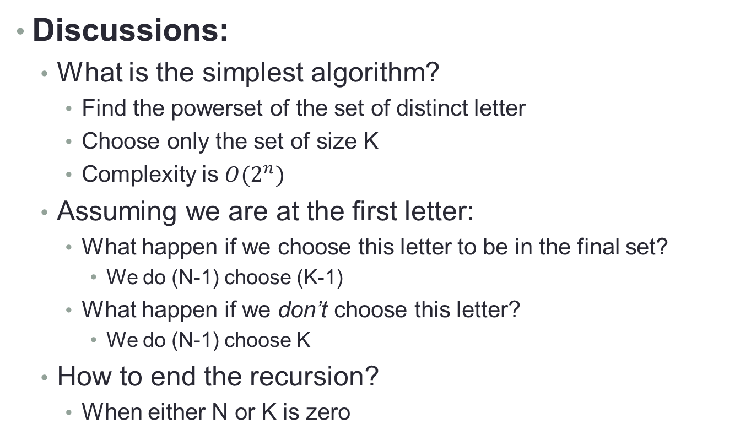
Ideas
Discussions:
What is the simplest algorithm?
Find the powerset of the set of distinct letter
Choose only the set of size K
Complexity is $O(2^{n})$
Assuming we are at the first letter:
What happen if we choose this letter to be in the final set?
We do (N-1) choose (K-1)
What happen if we don’t choose this letter?
We do (N-1) choose K
How to end the recursion?
When either N or K is zero

Slide 15

Recursion Tree
kOutOfN(2, “abcd”)
“a” + kOutOfN(1, “bcd”)
Recursion Formula:
$N choose K\left\{\begin{aligned}current substring, K=0 \\ \\ empty , N=0 \\ \\ \left(\left(N−1\right)choose \left(K−1\right)\right) \\ \begin{aligned}∪ \\ \left( \left(N−1\right)choose \left(K\right) \right)\end{aligned}\end{aligned}\right.$
“ab” + kOutOfN(0, “cd”)
Print “ab”; return
“ac” + kOutOfN(0, “d”)
Print “ac”; return
“ad” + kOutOfN(0, “”)
Print “ad”; return
“b” + kOutOfN(1, “cd”)
“bc” + kOutOfN(0, “d”)
Print “bc”; return
“bd” + kOutOfN(0, “”)
..………………………………..

Slide 16
Algorithm
N Choose K:
public LinkedList<String> kOutOfN (int K, String N, String pre) { LinkedList<String> result = new LinkedList<String>(); if (K == 0) { // Case: K = 0 result.add(pre); // Result is current substring } else if (N.length() == 0) { // Case: N = 0 // empty } else { result.addAll(kOutOfN(k-1, N.substring(1), pre+N.charAt(0))); result.addAll(kOutOfN(k, N.substring(1), pre); } return result; }

Slide 17
4. Knapsack
Recursion

Slide 18

Preliminary
Problem Description:
Given a knapsack capable of holding K-unit weight items, determine the number of possible ways of inserting N items with each of its own weight into the knapsack.
Input:
First line are integers N and K
Next line are N-integers
Output:
A single integer of how many ways of inserting
home
shop
knapsack

Slide 19
Example
Input:
5 6
3 1 6 4 5
Output:
9
Explanation:
There are 9 different sets of items with total weight not exceeding the capacity of your sack(6).
{} Empty sack Total weight = 0.
{3} Total weight = 3.
{3, 1} Total weight = 4.
{1} Total weight = 1.
{1, 4} Total weight = 5.
{1, 5} Total weight = 6.
{6} Total weight = 6.
{4} Total weight = 4.
{5} Total weight = 5.

Slide 20
Ideas
Discussions:
What is the simplest solution?
Find all possible combination (iterate through the powerset), and for each combination check if the total weight is less than or equal to maximum possible weight of knapsack
Assuming you are considering the first item:
What would you do if this item can be inserted into knapsack?
Consider the case where it is inserted
Consider the case where it is NOT inserted
What would you do if this item cannot be inserted into knapsack?
Ignore the case where it is inserted
Consider ONLY the case where it is NOT inserted

Slide 21
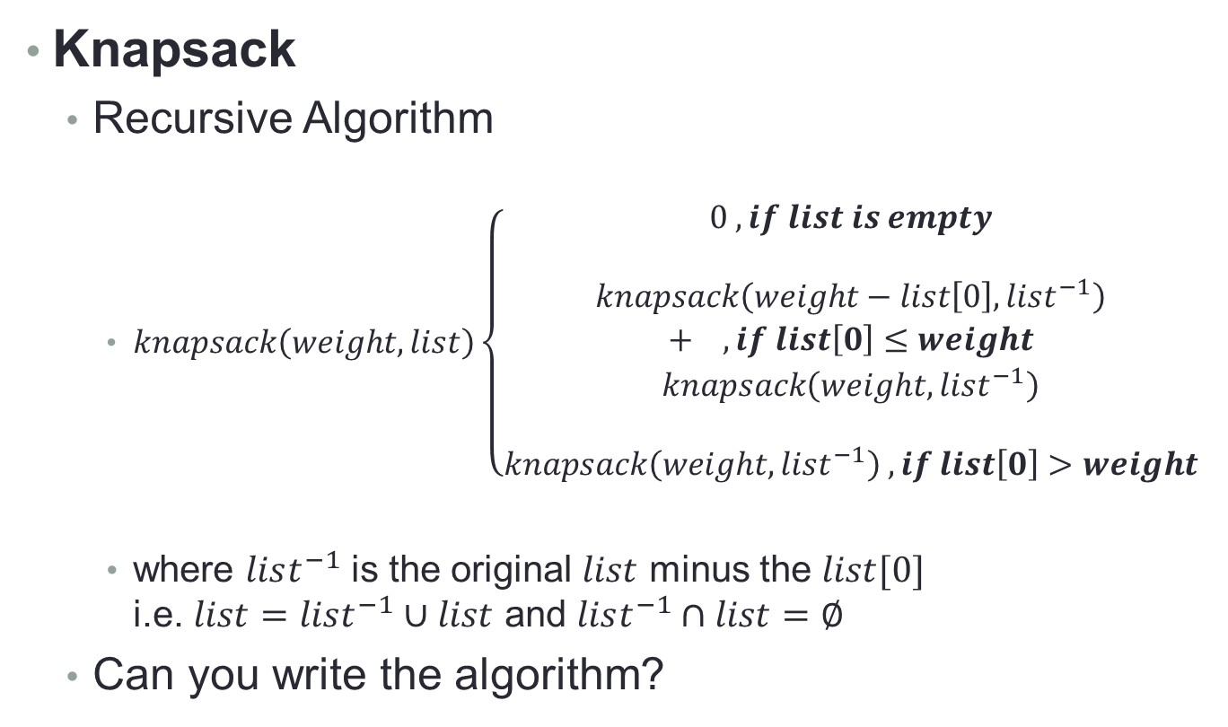
Algorithm
Knapsack
Recursive Algorithm
$knapsack\left(weight, list\right)\left\{\begin{aligned}0 , if list is empty \\ \\ knapsack\left(weight−list\left[0\right],list^{−1}\right) \\ + ,if list\left[0\right]≤weight \\ knapsack\left(weight,list^{−1}\right) \\ \\ knapsack\left(weight,list^{−1}\right) ,if list\left[0\right]>weight\end{aligned}\right.$
where $list^{−1}$ is the original $list$ minus the $list[0]$ i.e. $list=list^{−1}∪list$ and $list^{−1}∩list=∅$
Can you write the algorithm?

Slide 22
Challenge Yourself!
Further Problem:
What if, instead of finding the number of ways of arranging the items, you are required to know which combination gives the most items in the knapsack?
What do you need to change to fit the new problem?
Bedtime Stories:
http://jhave.org/learner/misc/knapsack/knapsack.shtml

Slide 23
5. STICK
Recursion

Slide 24
Preliminary
Problem Description:
Input:
N (1 <= N <= 15), number of sticks
X (1 <= X <= 20), the length of the new stick.
Next N lines contains the length of those sticks.
Output:
Minimum number of sticks required to join to form X.
Return -1 if not possible to form X.

Slide 25
Algorithm
Discussion
Find all combinations possible for given input sticks
Return the minimum number of sticks required to form X

Slide 26
Algorithm
How to find different combinations?
Consider a set {1,2,3}.
There can be 7 combinations
{1},{2},{3},{1,2},{1,3},{2,3},{1,2,3}
Remove the first element {1}
Three possibilities:
{1} can exist separately
{1} exist along with {2,3}
{1} does not exist along with {2,3}
Repeatedly perform this step to find all combinations

Slide 27
Pseudo Code
int recursive(vector<Integer> N, int sticks, int val)
if(N.size()>0)
Get the first element of vector N, store it in current and remove it from the vector
Find the number of sticks required to form X in the three cases:
a ← sticks+1 if((current+val) == X) else a ← MAXINT
b ← recursive(N, sticks, val)
c ← recursive(N, sticks+1, val+x)
Return the smallest out of a,b,c
else
if(val == MAX) return sticks
else return MAXINT
endif
endif
MAXINT is used to denote the -1 case when it is not possible to form X from give N sticks

Slide 28
6. Maths
Matrix and Recursion

Slide 29
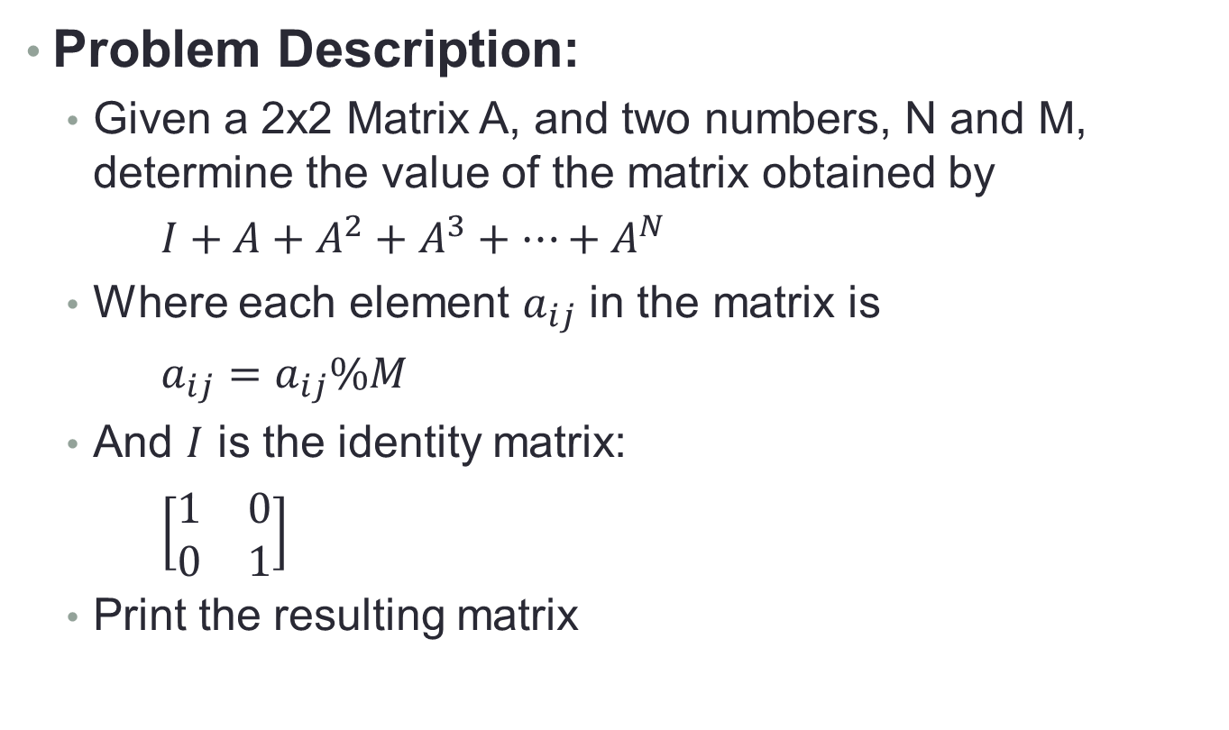
Preliminary
Problem Description:
Given a 2x2 Matrix A, and two numbers, N and M, determine the value of the matrix obtained by
$I+A+A^{2}+A^{3}+…+A^{N}$
Where each element $a_{ij}$ in the matrix is
$a_{ij}=a_{ij}\%M$
And $I$ is the identity matrix:
$\left[\begin{matrix}1 & 0 \\ 0 & 1\end{matrix}\right]$
Print the resulting matrix

Slide 30
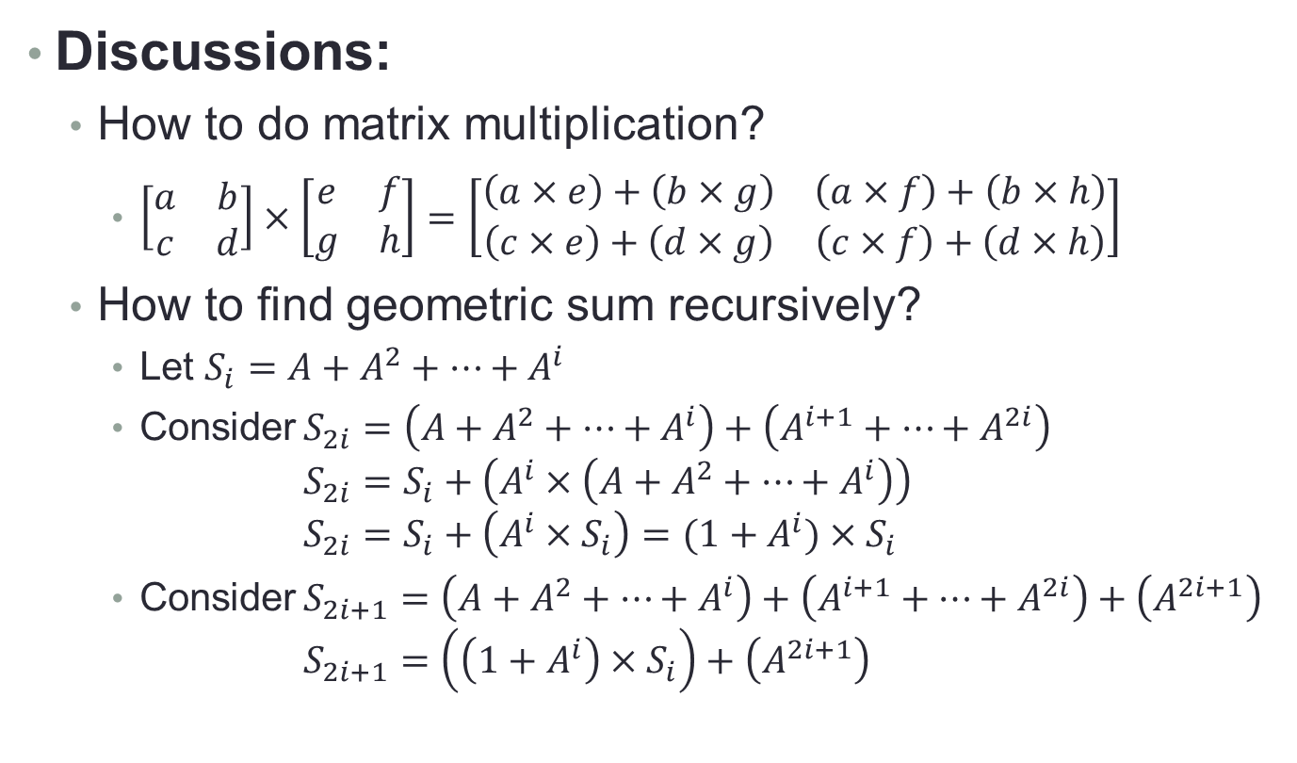
Ideas
Discussions:
How to do matrix multiplication?
$\left[\begin{matrix}a & b \\ c & d\end{matrix}\right]×\left[\begin{matrix}e & f \\ g & h\end{matrix}\right]=\left[\begin{matrix}\left(a×e\right)+\left(b×g\right) & \left(a×f\right)+\left(b×h\right) \\ \left(c×e\right)+\left(d×g\right) & \left(c×f\right)+\left(d×h\right)\end{matrix}\right]$
How to find geometric sum recursively?
Let $S_{i}=A+A^{2}+…+A^{i}$
Consider $S_{2i}=\left(A+A^{2}+…+A^{i}\right)+\left(A^{i+1}+…+A^{2i}\right)$ $S_{2i}=S_{i}+\left(A^{i}×\left(A+A^{2}+…+A^{i}\right)\right)$ $S_{2i}=S_{i}+\left(A^{i}×S_{i}\right)=(1+A^{i})×S_{i}$
Consider $S_{2i+1}=\left(A+A^{2}+…+A^{i}\right)+\left(A^{i+1}+…+A^{2i}\right)+\left(A^{2i+1}\right)$ $S_{2i+1}=\left(\left(1+A^{i}\right)×S_{i}\right)+\left(A^{2i+1}\right)$

Slide 31
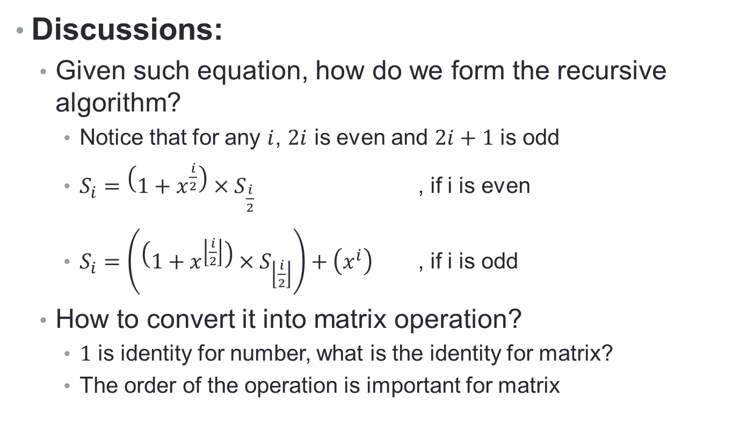
Ideas
Discussions:
Given such equation, how do we form the recursive algorithm?
Notice that for any $i$, $2i$ is even and $2i+1$ is odd
$S_{i}=\left(1+x^{\frac{i}{2}}\right)×S_{\frac{i}{2}}$ , if i is even
$S_{i}=\left(\left(1+x^{\left\lfloor \frac{i}{2}\right\rfloor }\right)×S_{\left\lfloor \frac{i}{2}\right\rfloor }\right)+\left(x^{i}\right)$ , if i is odd
How to convert it into matrix operation?
$1$ is identity for number, what is the identity for matrix?
The order of the operation is important for matrix

Slide 32
The End
Any Questions?

